Slide 1
Performing Calculations on Data
Objectives
Name group of data
Create formula to calculate values
Summarize data that meets specific conditions
Find and correct error in calculations

Slide 2
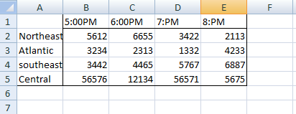
Naming group of Data
Select cells
Formula tab
Defined name group
Define name
New name dialog box appear , Type name in the name field.
4. Ok

Slide 3
Creating Formulas to Calculate Values
Formula begins with equal sign always
1.Go to Formula Tab
  Function library
  2. Insert function
  Dialog box appear with list of files, choose appropriate function required.

Slide 4
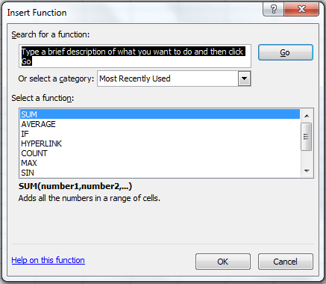

Slide 5
Most used function
SUM
AVERAGE
COUNT
MAX
MIN

Slide 6
Name range applicable in formula
Use absolute reference in formula to copy formula from formula bar.

Slide 7
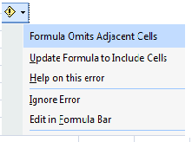
Finding and correcting errors in calculation
When cell with an erroneous formula is the active cell, error message appear by clicking error button

Slide 8
Most common error codes
Error Code
Description
#####
#VALUE!
#NAME?
#REF!
#DIV/0!
Column is not wide enough to display the value
Formula with wrong type of argument
Formula contains text that doesn’t recognize
Formula refers to a cell doesn’t exist
Formula attempts to divide 0

Slide 9
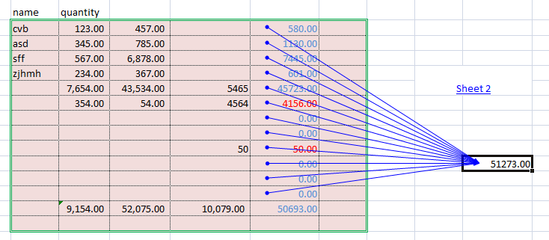
PRECEDENTS
To see which formuls refer to the values in the selected cell, use Trace Dependence; to see which cell provide values for the formula in the active cell, use Trace Presidence.

Slide 10
Changing Document Appearance
Objectives
Format a cell
Define Styles
Apply a work book Theme
Make numbers easier to read
Add an image to a document.

Slide 11
Formating Cells
Selecting cells
Home tab
Font
Color, Border
For change standard font Calibri
Micro Soft Office button,
Excel Option
Popular Page of dialog box
Choose Values
The new standard font does not take effect until quit Excel & restart the program

Slide 12
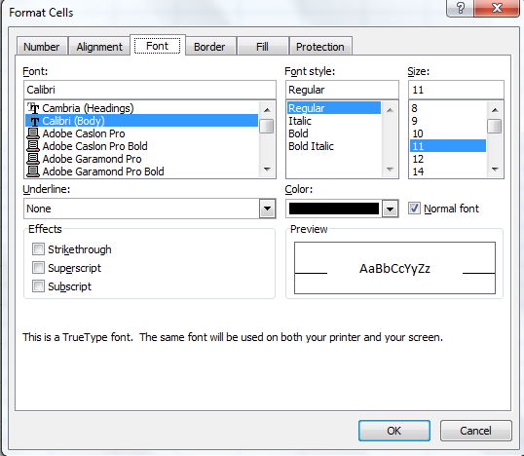
Defining Style
Home tab
styles
Cell styles ( New Style)

Slide 13
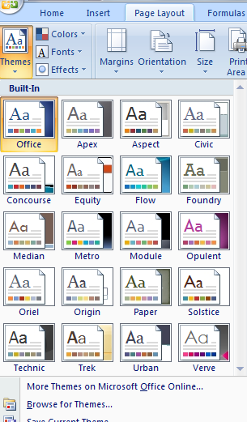
Applying Work book Themes & Table Styles
Page layout tab
Themes Group
Themes
select themes

Slide 14
Adding Images to a document
Insert tab
Illustration tab
Picture
Select Picture
To generate background on a worksheet
Page layout tab
Page setup
Background
Select image

Slide 15
STARTING A NEW PRESENTATION
OBJECTIVE
Quickly create a presentation
Create presentation based on a ready- made design
Convert an outline to a presentation

Slide 16
If we need help with both the presentation content and its look we can download a complete presentation from Microsoft Office Online and then customize it to meet your needs.
We can use any presentation that you have already defined
If we have content ready but need help with the look of the presentation, we can base your presentation on one of the design templates that comes with PowerPoint
If we created an outline of a presentation in Microsoft Office Word, we can import the outline into PowerPoint to create an instant slide show

Slide 17
Quickly creating a presentation
Microsoft Office Button
New
Microsoft office online
Presentations
Select option
Download

Slide 18
Creating Presentation Based on Ready-Made Design
To add new slide after the current slide by clicking Add Slide button in the Slides group on the Home tab
Microsoft office button
New
Microsoft office online
Design slides
Select option (in the center pane)

Slide 19
Converting an Outline to a presentation
Home tab
Slide groups
New Slide arrow
Slide from outline
Convert an outline
Overview pane
Outline tab

